Slide 1
Sales Analysis Dashboard

Slide 2
Objective
Design an interactive dashboard to analyze sales performance.
Track KPIs like Sales, Profit, and Growth.
Provide business insights across Region, Category, and Time.

Slide 3
Dataset Otverview
Dataset:sales_data.csv
Columns: Order ID , Product Name , Category , Region , Quantity Sold ,Unit Cost ,Unit Price , Sale Date
Source: Kaggle Sales Dataset

Slide 4
Key KPIs
KPI Formula
Total Sales - SUMX(Unit Price × Quantity) | Total revenue
Total Cost - SUMX(Unit Cost × Quantity) | Total expenses
Profit - Total Sales − Total Cost | Net earnings
Profit Margin (%) - Profit ÷ Sales × 100 | Profitability
Sales Growth (%) - Month-to-month growth | Trend tracking |

Slide 5
Dashboard Design Features
KPI Cards for totals
Time-series chart for sales trends
Bar chart by Region & Category
Slicers for interactivity (Region, Category)
Consistent color theme

Slide 6

Insights
Region X had the highest sales.
Category Y contributed most to profit margin.
Growth peaked in March with a 20% increase.
Recommended focus on high-performing products.

Slide 7
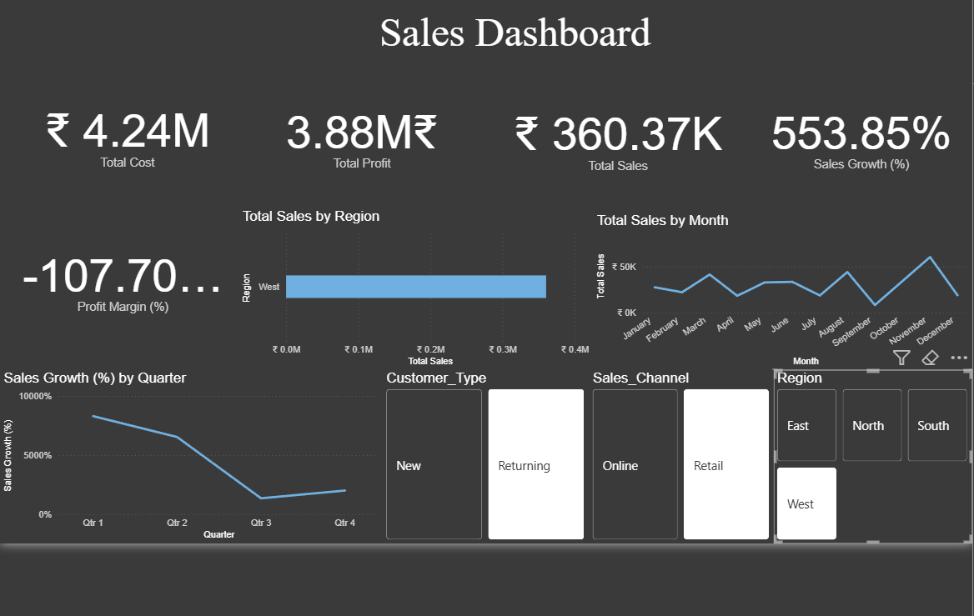

Slide 8
thank you
Aysha Mahshoofa
6363104435
ayshamahshoofa@gmail.com

